Slide 1

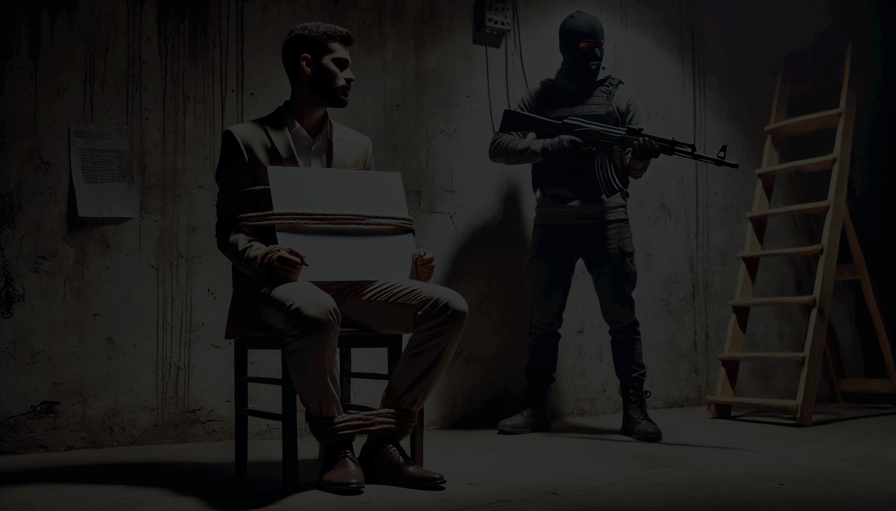
Negotiation: What, Why and How Hostage & Crisis Tactics for Everywhere
Dr. Nicholas Spooner
B.Eng (Aerospace) M.A.Sc (Biomedical) MBBS (Hons) FACEM AICGG
Notes:
Post nominals -> Technically proficient, but still struggled to influence.

Slide 2
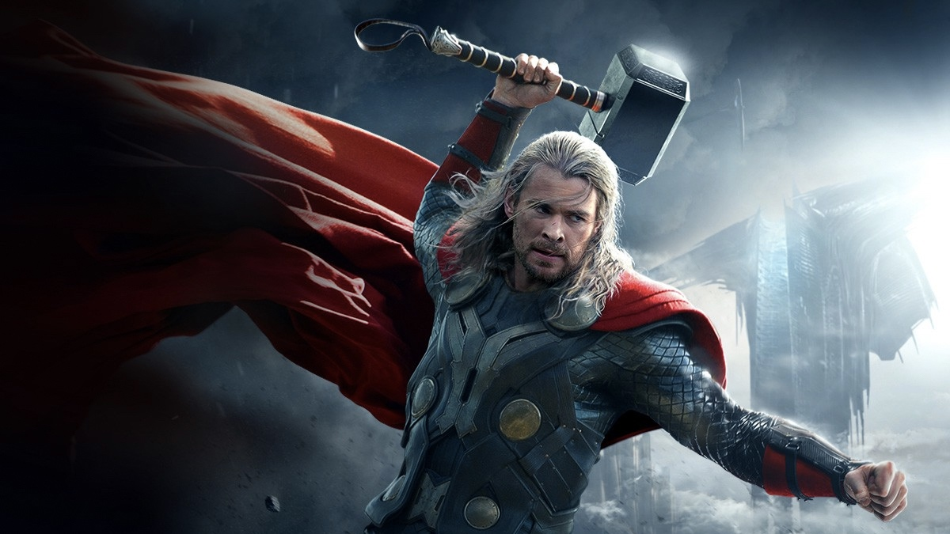
Notes:
When we bring a technical mind set without the requisite Non-Technical Skills, it's like wielding the hammer of truth.
To the person you’re bringing the hammer down on, the hammer only ever looks like a weapon… they get defensive and outcomes, relationships and productivity suffer.
Turned to Negotiation / Hostage / Conflict / Psychology
What does everyone do?
Sinclair Maths example.
What / Why for the girls and How for the boys

Slide 3
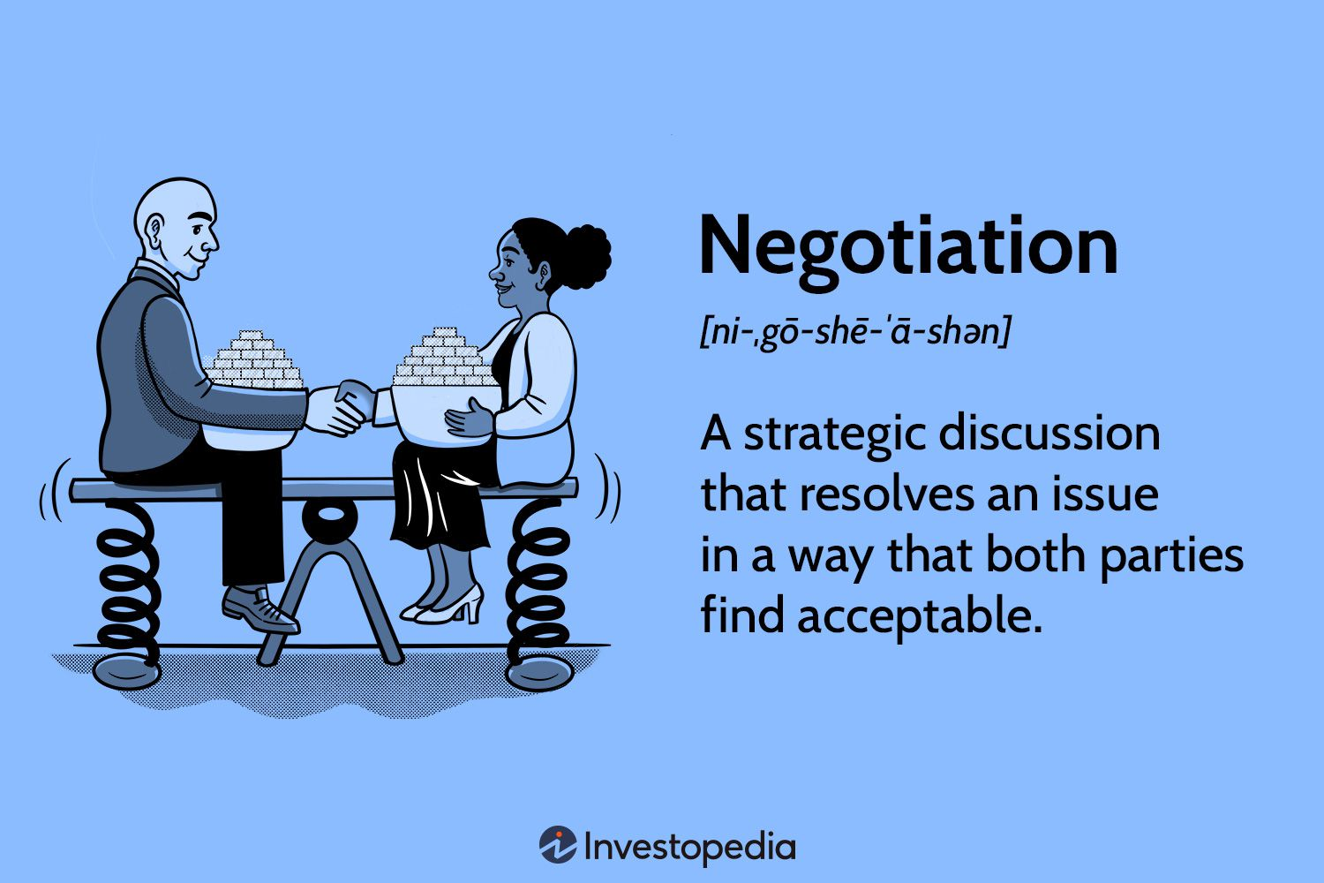
Importance of Negotiation Skills
Resolved Conflict
Creates Value
Builds Relationships
Increases Profits
Enhances Communication
Promotes Creativity

Slide 4

Negotiation Fundamentals
ZOPA
BATNA
Anchors
Negotiators Dilemma
Creating vs Claiming Value Paradigm
Notes:
We must cover the basics of Negotiation.
<--
If you already now this then, sit back, relax and have a wine / beer
or if you don't already know this...

Slide 5
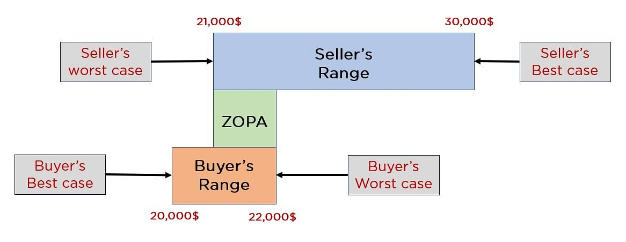
Zone of Possible Agreement (ZOPA)
Notes:
<--
Area between worst cases.
Its dynamic and we will learn how to change it...

Slide 6
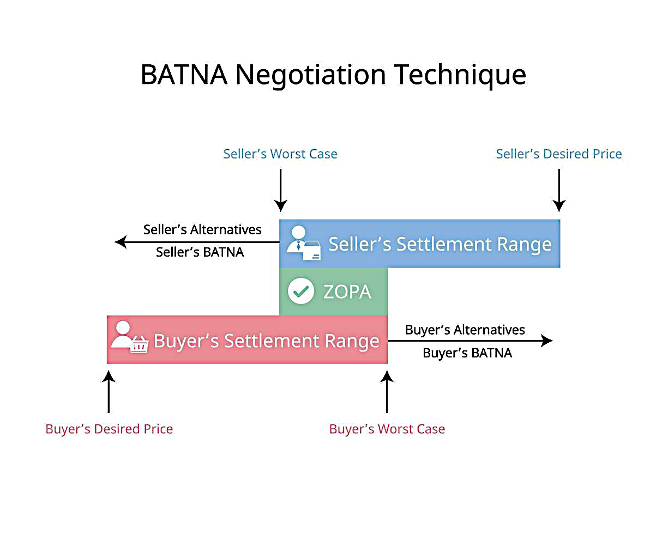
Best Alternative To A Negotiated Agreement (BATNA)
Fallback option if agreement can’t be reached
Notes:
<--
What happens if we stalemate?
What will I do if we can’t make this deal?
Powerful thought experiment.
Can be quite revealing and empowering.

Slide 7
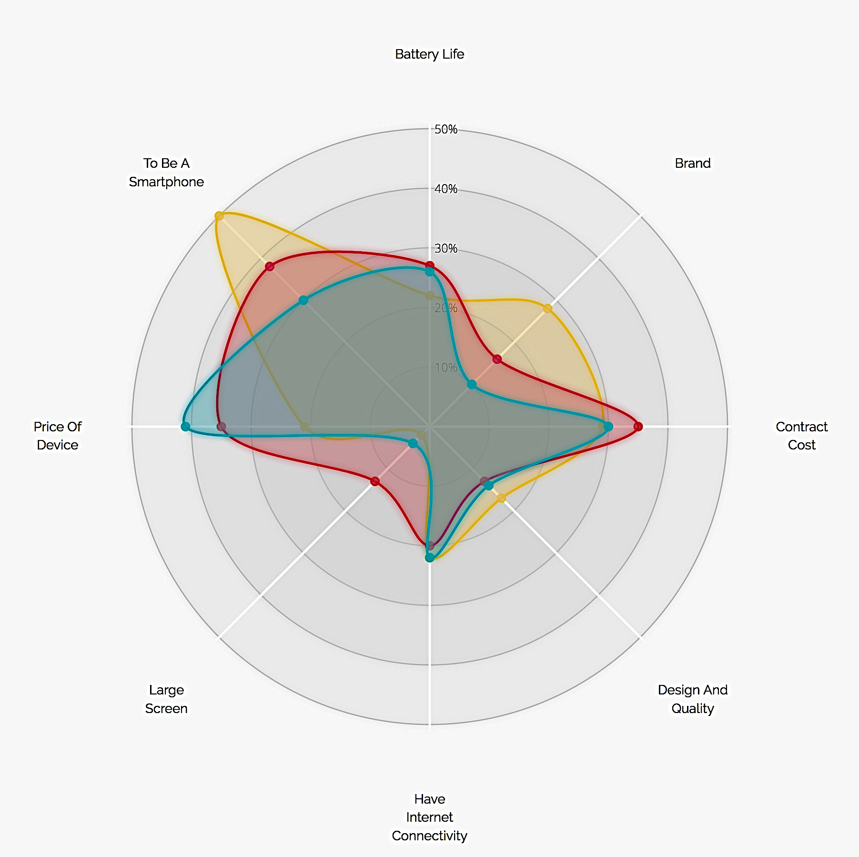
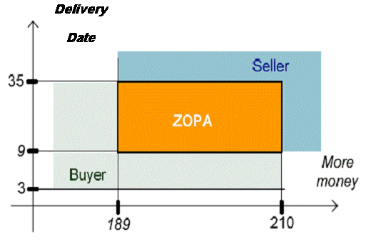
Multiple Issue Negotiation
Price
Payment Date
Delivery Date
Warranty Period
Servicing
Rebates
Commission
Salary
Work from Home
Location
Stock Options
Laptop / Mobile
Parking
Notes:
Often negotiations are not limited to single issues.
All studies and game theory conclude that multi-issue negotiations are best negotiated with the issues combined / as a package.
Whole 10hr module on multi-issue / package deal value based negotiation preparation, but in short...
You value each issues options / circumstances against a base option for comparison.

Slide 8
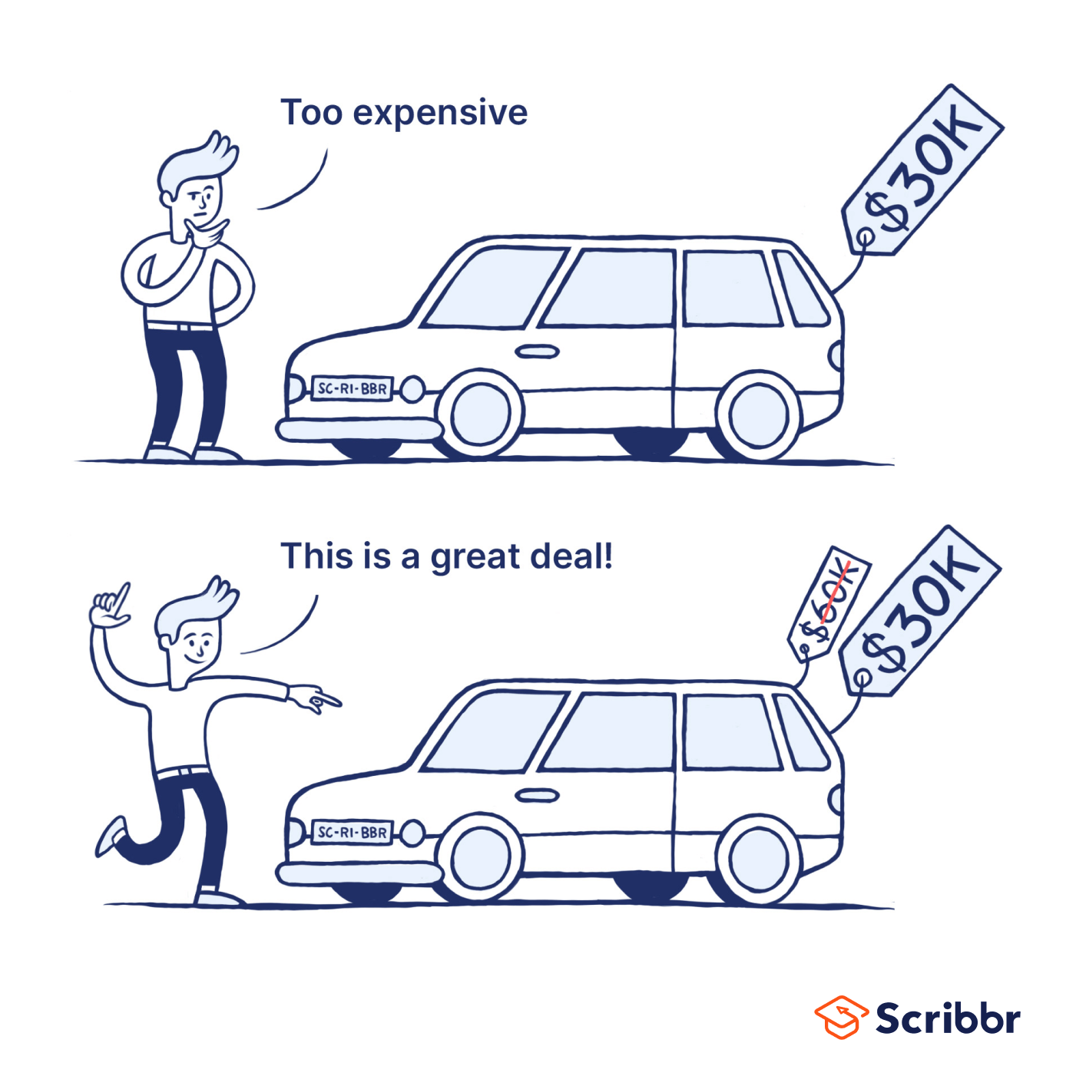
Anchoring Bias
Notes:
What is Anchoring Bias
The tendency to focus heavily on the first price in the context of a sale.
Experiment involving a roulette where participants witnessed a spin. They were then asked whether they thought that the percentage of UN member countries from Africa was greater or smaller than the number spun on the wheel and to estimate the true percentage.
When the wheel stop on 10, on average, px. guessed 25%.
Whereas, wheel stopped on 65, on average, guessed 45%.
A clearly random number... had a dramatic impact on people’s judgments.
What do we do with that information....?

Slide 9
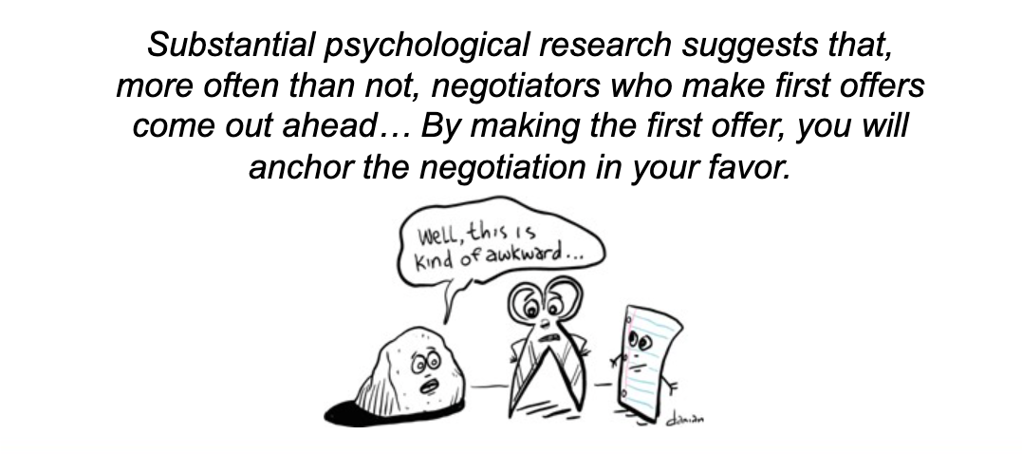
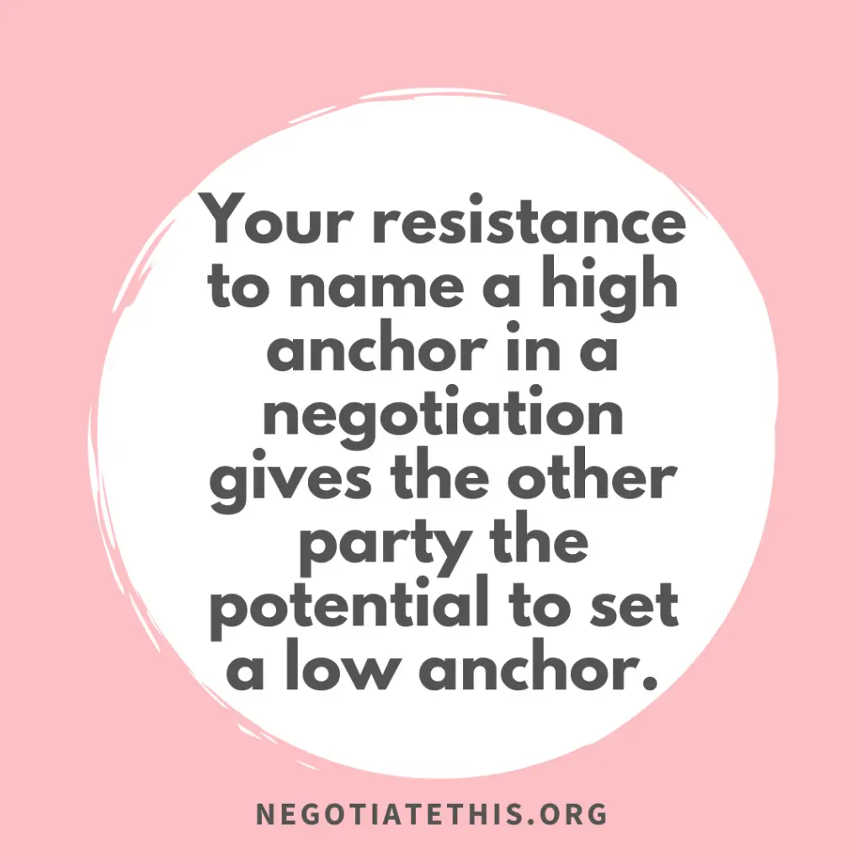
Anchors
Notes:
What's an Anchor?
Who goes first in a negotiation??
<---
The decision of whether to make the first offer should be based on two factors: your knowledge of the ZOPA — and your assessment of the other side’s knowledge of the ZOPA.
If all else fails, you should go first and go high / low relative your corresponding position.

Slide 10
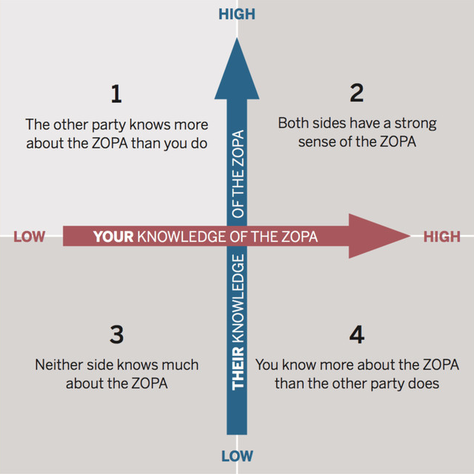
Anchors vs ZOPA
Notes:
We can take this one step further and actually do these thought experiments....
2,4,1,3

Slide 11
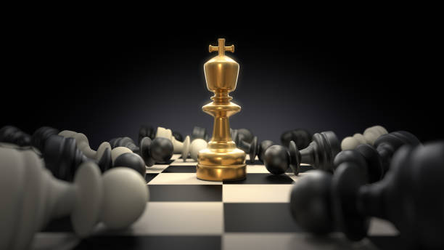
Negotiator’s Dilemma
Creating Value vs Claiming Value
Notes:
Does anyone know this Dilemma?
The methods are diametrically opposed.

Slide 12
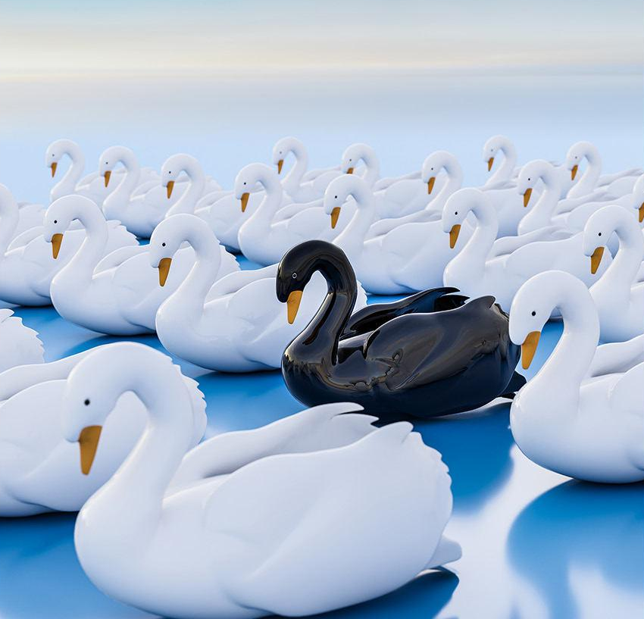
Value & Distribution
Competitive
vs
Collaborative
Expanding the Pie
Win Win
Unknown Unknowns
Black Swans
Notes:
Dinner and a movie analogy
your choices are at your spouse's expense - and compromise on both issues.
But if you look beyond fixed-pie and consider how much you value each of your choices
Cake analogy
Apple analogy
Active Listening, respect, politeness, authenticity -- Builds Trust
Shop analogy
- What are you hoping to do after you sell the shop? … Wow, a sailing trip.
Gift Certificate analogy
<<<------

Slide 13
Creating Value (Collaborative)
Advantages
Drawbacks
Value Maximization
Interests Satisfaction
Relationship Building
Enhanced Problem Solving
Time Consuming
High Trust Requirements
Emotional Challenges
Potential for Exploitation

Slide 14
Claiming Value ( Competitive)
Advantages
Drawbacks
Efficient
Simplicity
Competitive Advantage
Less Reliance on Relationships
Strained Relations
Loss of Opportunities
Risk of Deadlock
Loss of Future Cooperation

Slide 15
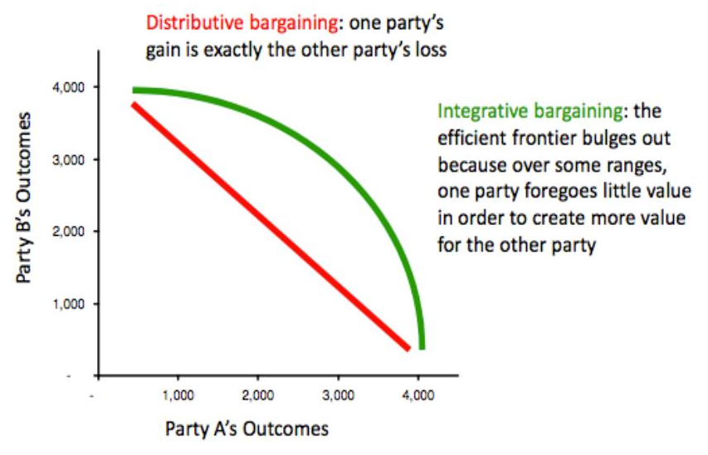

Slide 16
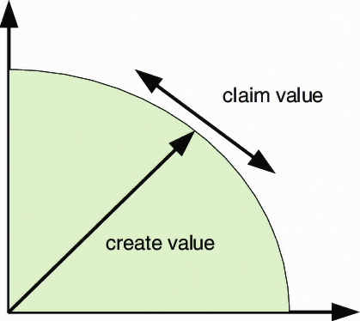

Slide 17
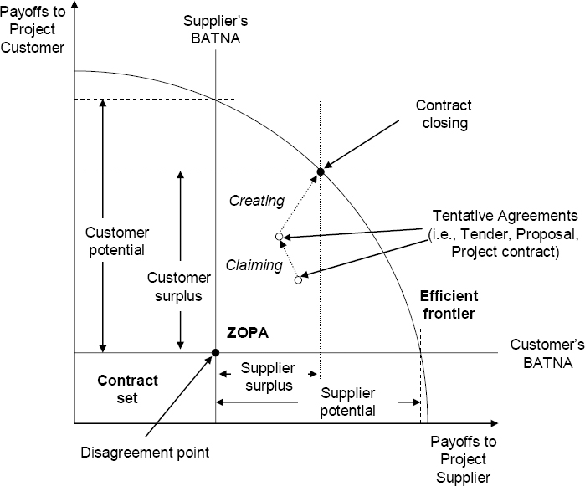

Slide 18

Key Take Home Message
BATNA → Negotiators Dilemma
Notes:
Key Take Homes:
BATNA helps dictate how you approach every negotiation and the Negotiators Dilemma.
Almost everything is a Negotiation:
If you could be harmed or not help by someone doing nothing, that is a Negotiation.
3-7-12 / day
Coffee, Airline / Hotel Check In, almost any customer service interaction.
At work… Clinical, staff, patients and admin (process changes, salary, personal aspects of work, career advancement, Quality Initiatives…)
At home… Spouse, Kids, Relative.
PAUSE.....
However it is now……….it could be better, you could do better.
Thursday! I’m going to tell you How?

Slide 19
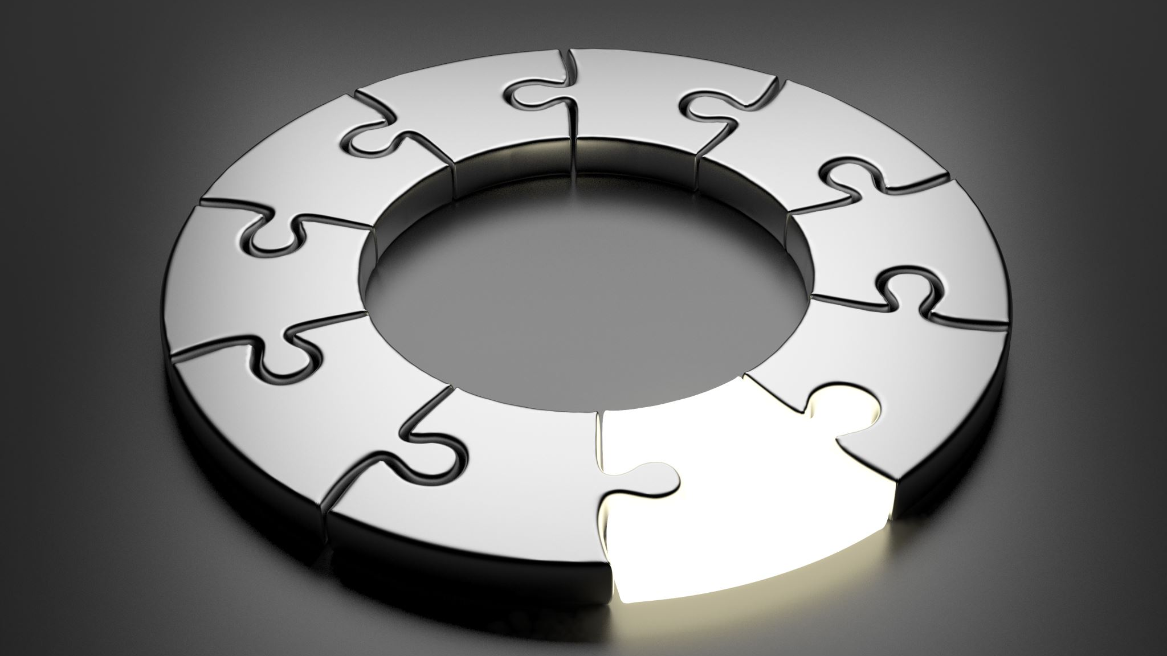
How
Part 2 – Main Course
Notes:
Just a preface to the presentation -- We are going to use this stuff for good and not evil.
You certainly can use it selfishly, but karmas a bitch.
So for all intense and purposes, we are learning this to be used authentically and altruistically.

Slide 20

Why do smart people fail?
IQ ≭ EQ

Slide 21
The Practical "How"
Tactical Empathy
Trust Base Influence
Late Night DJ
Mirrors
Labels
Calibrated Questions
“No” Oriented Questions
That’s Right
Never Split the Difference
Accusation Audit
Notes:
<---
Some of these will feel awkward, difficult and even forced – the antidote is Practice.
Ruthlessly Plagiarized Example of somethings difficult.
What is felt as Difficulty is actually the creation of a new neural pathway.
Finger / Thumb
How many times do you need to try that before you can "get it"?
63
Practice makes perfect. Use these communication skills in low-stakes scenarios to start.

Slide 22
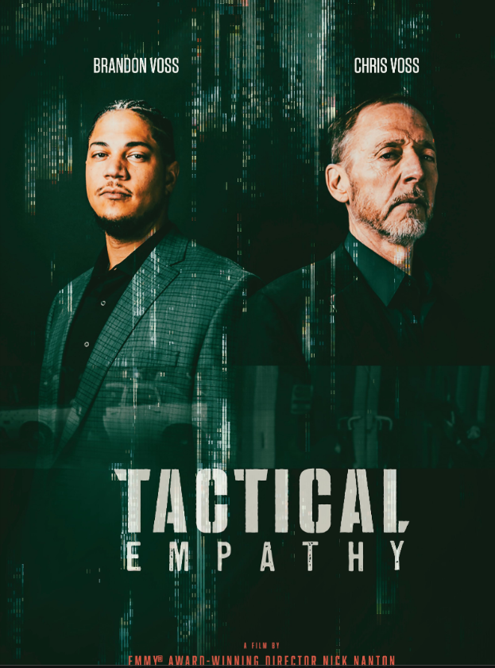
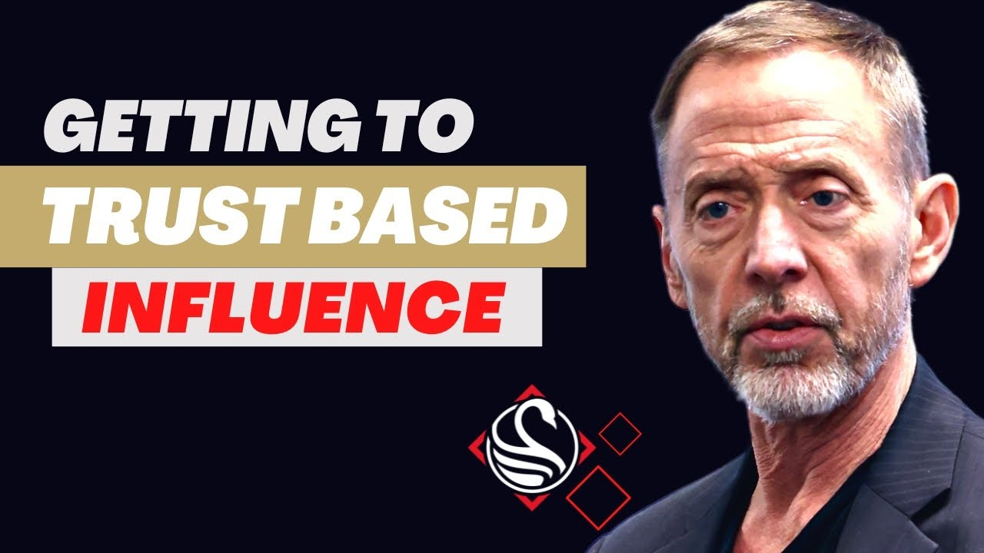
Tactical Empathy & Trust Based Influence
Notes:
This is Chris Voss, Head of FBI Hostage Negotiation for 20 years. Then Harvard Business School and now Black Swab Group.
What is Tactical Empathy… It’s just empathy, with "tactical" added on because that sounds cool and got people to buy in / buy a book / buy the idea.
But...Empathy builds Trust -- and with Trust we can influence in that authentic genuine way.
We want the:
Best Understanding between the groups.
Best Deal, but with the Best Relationship
Push them to their very very very best offer and still be able to collaborate after that.
But...You don’t want to make an offer where they say “Ok that sounds great”, WHY? What did you leave on the table?1!!
Best Execution
We don’t want to use this stuff to make or expect people to do things they can’t or shouldn't do…
We just want to ensure that we get every last drop out of them, that they can do / and are willing and able to do for us…

Slide 23
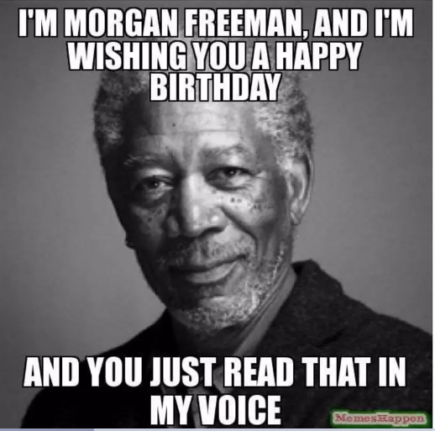
Tone
Late Night DJ Voice
Notes:
We will quickly touch on Tone.
The tone isn’t passive, passive aggressive, it isn't aggressive, it isn’t assertive, it isn’t anxious or pressured.
It is the ...late… night … DJ ... Voice.

Slide 24
Mirrors
Notes:
Now we'll get into techniques...
If you wanted a Jedi mind trick to plant Empathy and Trust into people's brains it's Mirroring, or Isopraxism for real keen beans, but we'll stick with mirroring.
Mirroring is when two individuals unconsciously match each other's body language and movements.
When used consciously, it is an incredibly effective way to build rapport and create a sense of trust and understanding between two people.
This isn’t limited to just body movements – In negotiation we ‘mirror’ verbal conversational patterns.

Slide 25
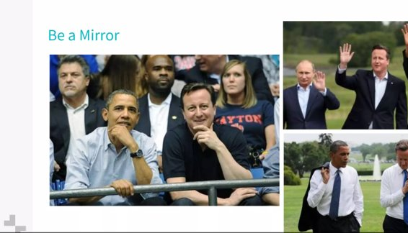

Mirrors
A "mirror" is when you repeat the last three words (or the critical ones to three words) of what someone has just said.
Notes:
<--
Mirroring is used to connect with others -- Insinuating similarity facilitates bonding
This immediately establishes a positive, subconscious commonality between two people.
People Love to be encourage to “go on…”
It Builds rapport, allows you to understand interests and overcomes objections.
It Can even reduce stress in others by the sense of familiarity and comfort.
People feel Heard and understood -- You're on the same Wavelength with them. -- You’ve Expressed a genuine interest.
This accelerated Bonding → Tactical Empathy
Listen attentively and encourage them to share about themselves -- Dyanamic Silence.
Mirroring's benefits also extend to:
Social bonding and cooperation in a team.
Leadership and forming a productive team.
Improved communication and flow in teams.

Slide 26
Calibrated Questions
What Questions
How Questions
What is the core issue here?
What is the biggest challenge you face?
What happens if we fail?
What position are you in if this doesn’t change?
What happens if you do nothing?
What about this is important for you?
How is that worthwhile?
How have you handled this in the past?
How long are you willing to wait?
How does that affect things?
How would you like me to proceed?
How can I help make this better for you?
How am I supposed to do that?
Notes:
Calibrated Questions are How and What questions, because the other W’s make no sense.
Calibrated questions are easy to dismiss as everyday open-ended questions, but they’re more precise in how they get the discussion moving forward.
They’re designed to acknowledge the other side's skill, knowledge and experience. -- Who wouldn't want that!!!
They Introduce ideas and requests that may otherwise feel “pushy”. These ideas may then come from the other side and thus appear to be their ideas.
<--

Slide 27
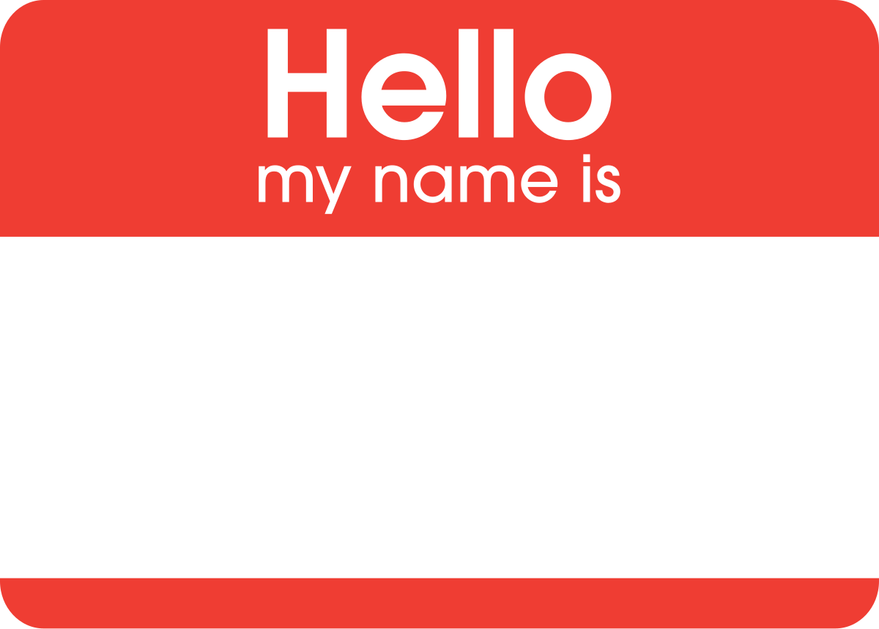
Labels
Verbal observation of feelings
It seems/sounds/looks
Notes:
Labels are a Verbally observed dynamic or feeling that is not on the surface.
A statement in the form of It seems / it sounds / it looks like... and then..
Respectfully repeat back the recognised emotion that you see or perceive.
EXAMPLE (Can anyone think of a scenario where someone was angry, frustrated, stuck)
People feel validated and understood.
Rapid bonding moment. Cut through the B.S. …
Obviously helps Building report and trust → Tactical Empathy.
You can even label it wrong… people will correct you with truth, opening a dialogue and ... getting the truth.

Slide 28
“No” Oriented Questions
”No” is comfortable, safe and secure.
People feel anxious when they sense you’re seeking a “Yes”.
“Excuse me, do you like vacations”?
Notes:
Has anyone heard of Yes momentum or a Yes 'able proposition?....
Getting someone to say Yes to a lot of little things, leading up to the big YES.
Yes is commitment, commitment creates anxiety, which interferes with peoples thought processes.
We are already thinking "What’s the catch, what’s the hook."
Therefore, Yes lacks emotional intelligence because we know it brings anxiety!!! -- From Neuroscience we know that Anxiety slows brain.
No is safe and secure and helps people think.
- Hey Dad, can I get a new iPad??? Ahhhh NO.
People feel anxious when they sense you are seeking a yes. Don’t believe me?
Here’s an example for you. As you’re exiting your local supermarket, someone stops you as you exit and asks… “Excuse me, do you like ski holiday's in Japan?” Can you feel that? Even though the answer is very likely yes, you feel hesitant to answer right?

Slide 29

“No” Oriented Questions
Have you given up on... ?
Is it ridiculous... ?
Would it be horrible... ?
Is it a bad idea... ?
Is now a bad time to talk… ?
Notes:
Just flip your yes-oriented questions into no-oriented questions.
Generating a no-oriented question relieves your counterpart from wondering what they are getting themselves into if they agree. Nearly every yes-oriented question you ask can be reoriented by adding phrases like these to your statement:
<---
Low stakes practice…like the next time you want to suggest a place to eat. Instead of, “Can we have Korean barbecue tonight?” Replace it with, “Would it be horrible if we went to Korean barbecue tonight?”
Is it a ridiculous idea to leverage our human inclination to say no to get things done?
Next level….and take the gloves off.. only for good, not for evil...try..
Is sounds like you’re POWERLESS here...
It seems like there is nothing I can say…
Must watch the Tone so these land the way you want... read the room.

Slide 30
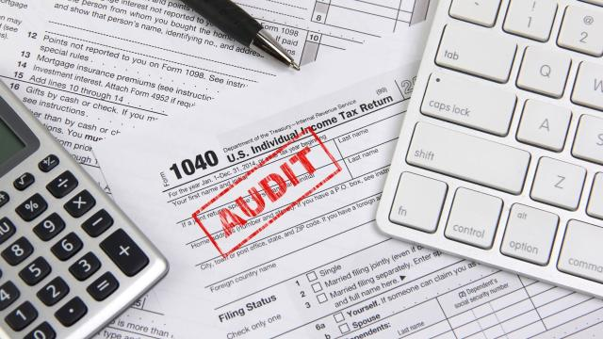
Accusations Audit
Proactively addressing negative emotions
All negative
Fair or Unfair
True or Untrue
Structure
You may, You might, You probably
Notes:
←
Forgot the milk analogy (irresponsible, selfish, never listen)
- Worse case scenario (wrecked the car, lost the dog, gambled the savings…)
Higher you raise the expectations of bad news, the further they fall when they hear your real issue.
Shows Willingness and intention to identify the negative and to make them go away so you can move forward as collaborators.
Dissolves, reduces, diffuses the negatives. -- Takes away permission and authority to use it against us later.
When will we use these: Beginning, before an Ask, before Bad New.
Let say the other side actually feels that way, nothing builds trust faster than feeling understood or someone being self aware.-- You’re preemptive and dialed into them by addressing some of their concerns up front.
It Clears the mind when you tell them all the negatives, they can let go.
It Doesn’t plant the thought. "You probably think I’m a greedy, lying son of a bitch…"
As long as you don't say “I don’t want you to think, feel” – Don’t Deny, When you deny peoples Guard goes up because the Fear of negative reaction, you showed, is read by them with uncertainty and even weakness.

Slide 31
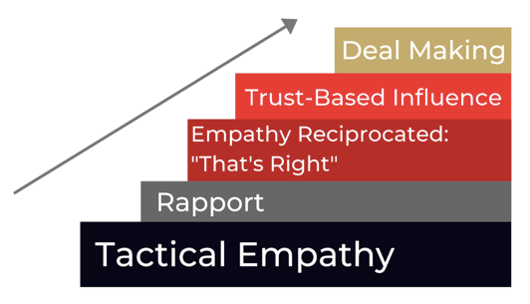
That’s Right
How your Grandmother wanted you to treat other people.
Notes:
That's Right is about demonstrating understanding, by paraphrasing / summarizing the other side's argument to the point where you get a “That’s Right” from them.
or a "That’s not it, this is it" → you've opened a Dialogue and you can continue to seek a That's Right
You've heard the saying Seek first to understand and then to be understood.
You can’t just say “I understand, I understand you”
You must show them you understand.
Demonstrating your understanding of their total complete truth -- that will bring an epiphany for them, it brings a chemical change that builds trust → Tactical Empathy
Yelling at TV analogy [not you’re right, That’s Right]

Slide 32
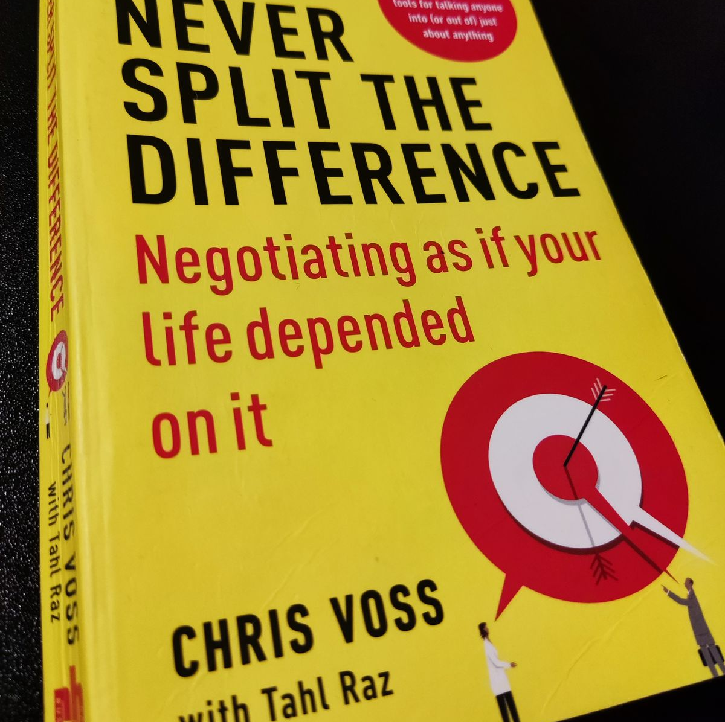
Never Split the Difference
Suckers Move
Fools Move
Notes:
Suckers move
- Everyone jacks up their prices so they land where they wanted to anyways
Fools move
- Bending too ideas together [black shoe, brown shoe. One of each]
Neither are good
Instead: build rapport to ensure the other side will give you the best deal they can, be keen to execute the deal and be prepared to deal with you again.

Slide 33
Ackerman Model
65,85,95 rule
Last offer is very precise with a 3 or a 7 at the end.
And a funny or ridiculous extra

Slide 34

Questions, Comments, Suggestions

